Slide 2
Tap-changing Transformers
Most power transformers have tappings on coils brought out to terminals so that the number of turns on one winding can be changed
The turns ratios are changed in order
(a) to maintain the secondary voltage at their rated value under the varying conditions of load and power factor. The secondary terminal voltage may vary with changes in load over an undesirably large range, because of changes in the impedance drop in the transmission lines and transformers

Slide 3
Tap-changing Transformers
(b) to control the flow of reactive power between two interconnected power systems or between component parts of the same system, at the same time permitting the voltages at specified points to be maintained at desired values.

Slide 4
Tap-changing Transformers
Tappings on power transformers permit voltage adjustment with ± 5%.
Low – and medium – power transformers usually have three taps per phase: +5%, 0 and -5% variations in the turns ration
Higher power usually have five: 5%, +2.5%, 0%, -2.5% and 5% variations in the turns ratio.
The principal tapping “0” is that to which the rating of the winding is related.

Slide 5
Tap-changing Transformers
A positive tapping includes more, and a negative less turns than those of the principal tapping
Tappings are usually fitted on the higher voltage winding to obtain tappings within fine limits.
Consider say, 11kV / 433 V, 600 kVA delta-star distribution transformer having volts / turn = 10.

Slide 6
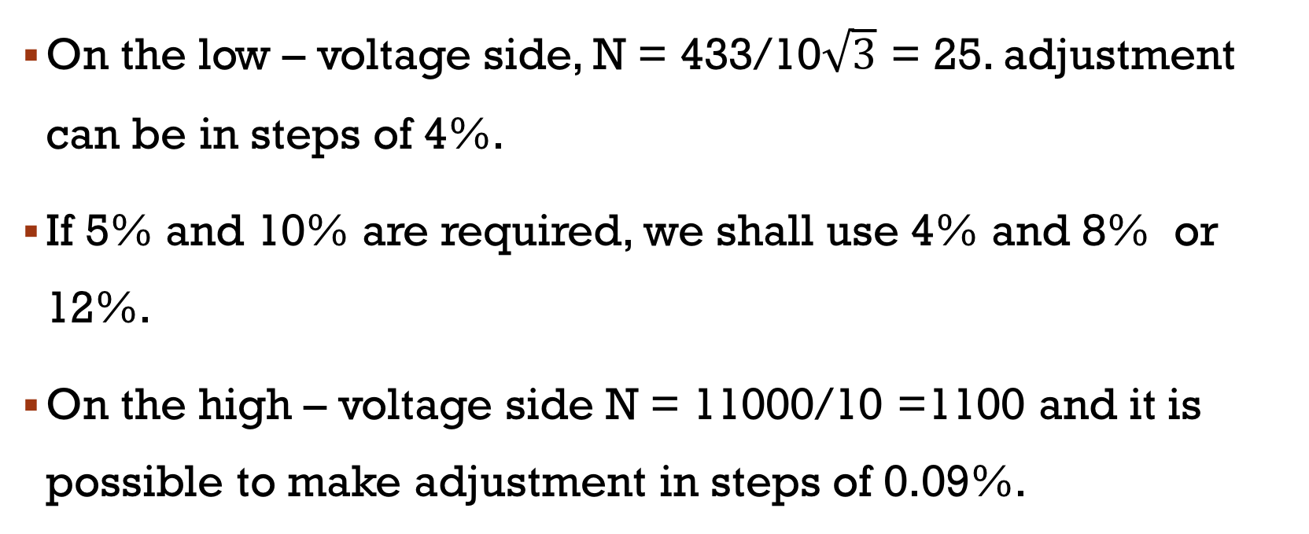
Tap-changing Transformers
On the low – voltage side, N = 433/10$\sqrt{3}$ = 25. adjustment can be in steps of 4%.
If 5% and 10% are required, we shall use 4% and 8% or 12%.
On the high – voltage side N = 11000/10 =1100 and it is possible to make adjustment in steps of 0.09%.

Slide 7
Changing the taps of transformers
Tap-changing may be either on-load or off-load.tap-changing
(a) Off-load tap changing:
the changes are made when the transformer is disconnected from the primary circuit.
The most common off-load tap changing transformer has tappings inside the tank and connected to an internal switch which is operated by an external switch handle (usually by rotary movement of a handwheel).

Slide 8
Off-load tap changing
Off-load tap changing is simple and inexpensive and it is commonly used with distribution transformers where occasional adjustments are required.

Slide 9
On-load tap changing
Daily and short-time adjustment is generally by means of on-load tap-changing gear
Tap changing is done without breaking the circuit
Momentary connection must be made simultaneously to two adjacent taps during the transition, and the short-circuit current between them must be limited by some form of impedance known as transition impedance.

Slide 10
Centre-tapped iron-core inductors (the reactor method) or resistors (the resistor method) are used for this purpose
Reactor method: This method has now almost entirely been superseded by the resistor method.
Resistor method: In modern designs the transition impedance is almost invariably obtained by means of a pair of resistors.

Slide 12
AUTOTRANSFORMER
An autotransformer has a single winding on an iron core and a part of winding is common to both the primary and secondary circuits
An autotransformer has a single tapped winding which serves both primary and secondary functions

Slide 13
AUTOTRANSFORMER
In each case, I₁ is the input current and I₂ is the output or load current.
Regardless of autotransformer connection (step-up or step-down), the current in the portion of the winding that is common to both the primary and the secondary is the difference between these currents (I₁ and I₂).
The relative direction of the current through the common portion of the winding depends upon the connections of the autotransformer.

Slide 14
AUTOTRANSFORMER
It is because the type of connection determines whether input current I₁ or output current I₂ is larger
For step-down autotransformer I₂ > I₁ (as for 2-winding transformer) so that I₂ − I₁ current flows through the common portion of the winding
For step-up autotransformer, I₂ < I₁. Therefore, I₁ − I₂ current flows in the common portion of the winding.

Slide 16
AUTOTRANSFORMER EQUATION
If losses, leakage flux and magnetizing current are neglected

Slide 17
Advantages of autotransformer over two – winding transformer
The main advantage gained in the use of autotransformer is the saving of copper
For a two-winding transformer and an autotransformer which can perform the same duty (they should have the same voltage per turn and therefore the same flux. We can also assume the same mean length per turn)

Slide 18
Advantages of autotransformer over two – winding transformer

Slide 19
Advantages of autotransformer over two – winding transformer
An autotransformer operates at a higher efficiency than a two-winding transformer of similar rating
An autotransformer has better voltage regulation than a two-winding transformer of the same rating.
An autotransformer has smaller size than a two-winding transformer of the same rating
An autotransformer requires smaller exciting current than a two-winding transformer of the same rating

Slide 20
disadvantages of autotransformer over two – winding transformer
There is a direct connection between the primary and secondary. Therefore, the output is no longer isolated from the input

Slide 21
disadvantages of autotransformer over two – winding transformer
An autotransformer is not safe for stepping down a high voltage to a low voltage. As an illustration, the Figure on the next slide shows 11000/230 V step-down autotransformer. If an open circuit develops in the common portion 2-3 of the winding, then full-primary voltage (i.e., 11000 V in this case) will appear across the load. In such a case, any one coming in contact with the secondary is subjected to high voltage. This could be dangerous to both the persons and equipment. For this reason, autotransformers are prohibited for general use.

Slide 22
disadvantages of autotransformer over two – winding transformer

Slide 23
disadvantages of autotransformer over two – winding transformer
The short-circuit current is much larger than for the two-winding transformer of the same rating. It can be seen from the Figure on the previous slide that a short-circuited secondary causes part of the primary also to be shortcircuited. This reduces the effective resistance and reactance.

Slide 24
question
An autotransformer is required to step up a voltage from 220 to 250 V. The total number of turns is 2000. Determine (a) the position of the tapping point (b) the approximate value of the current in each part of the winding when the output is 10 kVA and (c) the economy in copper over the two winding transformer having the same peak flux and the same mean length per turn.

Slide 25
SOLUTION

Slide 26
Two-winding transformer connected as an autotransformer
A two-winding transformer can be changed into an autotransformer by connecting the primary and secondary windings in series. The following rules apply whenever a two-winding transformer is connected as autotransformer:
(a) the current in any winding should not exceed its current rating
(b) the voltage across any winding should not exceed its voltage rating

Slide 27
Two-winding transformer connected as an autotransformer
(c) rated current in one winding gives rise to rated current in the other
(d) rated voltage across one winding gives rise to rated voltage across the other
(e) if current in one winding flows from say A₂ to A₁, then current in the other winding must flow from a1 to a2 and vice versa
(f) the voltages add when terminals of opposite polarity (A₁ and a₂ or A₂ and a₁) are connected together by a jumper. The voltages subtract when A₁ and a₁ (or A₂ and a₂) are connected together.

Slide 28
Applications of Autotransformers
Autotransformers are used to compensate for voltage drops in transmission and distribution lines. When used for this purpose, they are known as booster transformers.
Autotransformers are used for reducing the voltage supplied to a.c. motors during the starting period.
Autotransformers are used for continuously variable supply

Slide 29
INSTRUMENT TRANSFORMERS
They are used in ac circuits to serve these purposes:
(a) to make possible the measurement of high voltages with low-voltage instruments or large currents with low current ammeters
(b) to insulate high voltage circuits being monitored from measuring circuit in order to protect the measuring apparatus and operator
(c) to energize relays for the operation of protective and automatic control devices

Slide 30
The load on the secondary of an instrument transformer is called its burden and is expressed in volt-amperes (VA). There are two types of instrument transformers: the voltage (or potential) transformer and the current transformer

Slide 31
The voltage or potential transformers (VTs or PTs)
The primary is connected directly to the power circuit either between two phases or between a phase and ground and the secondary is connected to instruments and coils of relays
Sufficient insulation is provided between the primary and the secondary to withstand the full line voltage as well as the very high impulse voltage.

Slide 32
The voltage or potential transformers (VTs or PTs)
Voltage transformers are designed to step down the primary voltage to a nominal or rated voltage of 110 V so that standard instruments and relays can be used.

Slide 33
The voltage or potential transformers (VTs or PTs)

Slide 34
Current transformers (CTs)
Their primary consists of small number of turns connected in series with the power circuit load
The secondary consists of a larger number of turns and it is connected to ammeter, current coils of other instruments or current coils of relays.
The nominal or rated secondary currents are usually 5 A or 1 A, irrespective of the primary current rating.

Slide 35
Current transformers (CTs)

